Slide 1
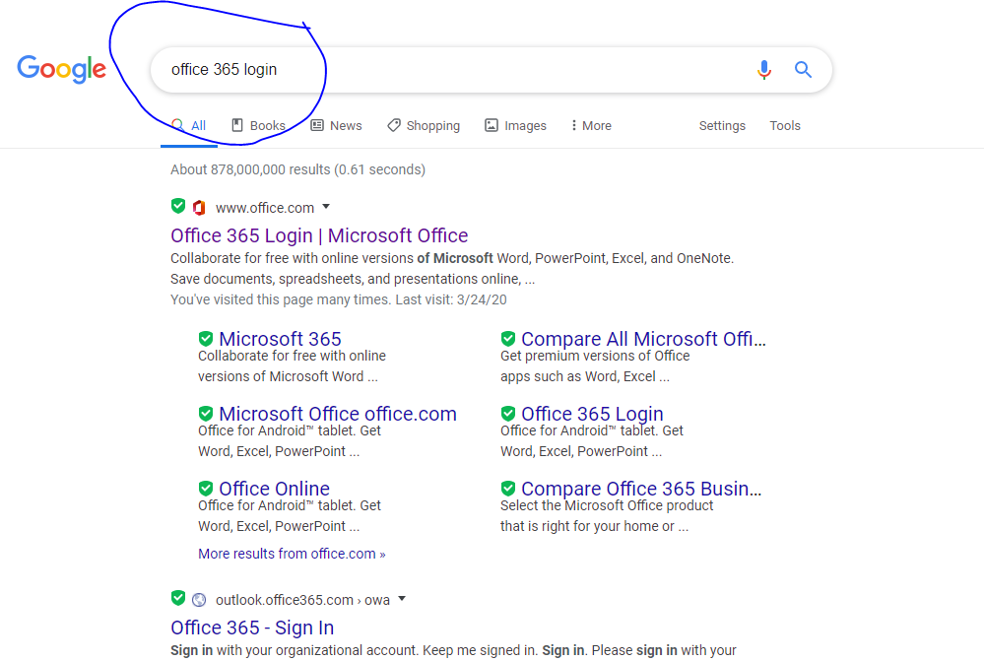
In Google type in Office 365 Login

Slide 2
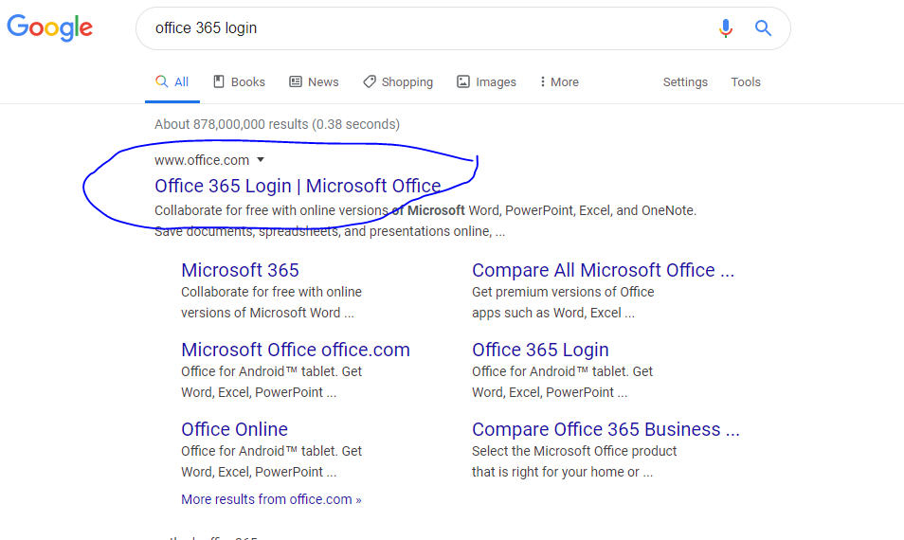
Select office 365 login/ Microsoft office

Slide 3
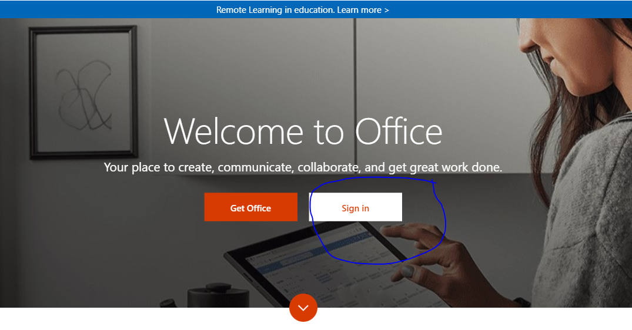
Select Sign in

Slide 4
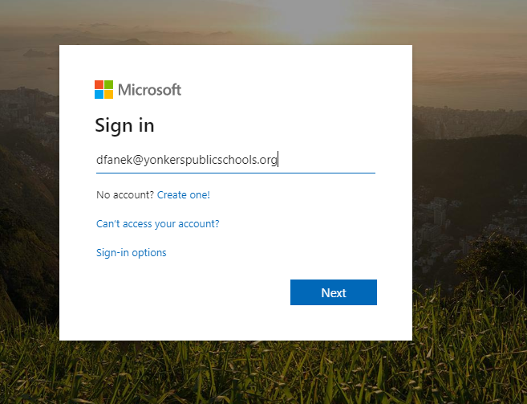
6 Digit student ID@yonkerspublicschools.org
EXAMPLE: 987654@yonkerspublicschools.org

Slide 5
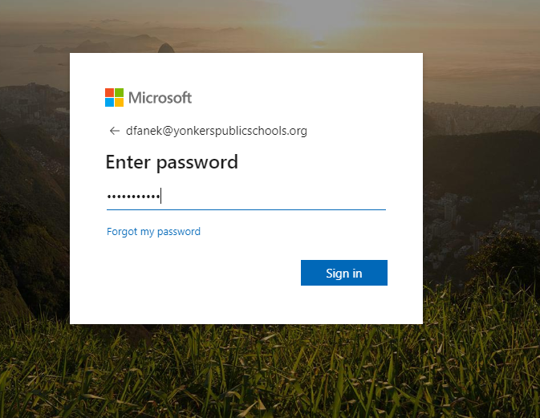
Password used to log into school computers

Slide 6
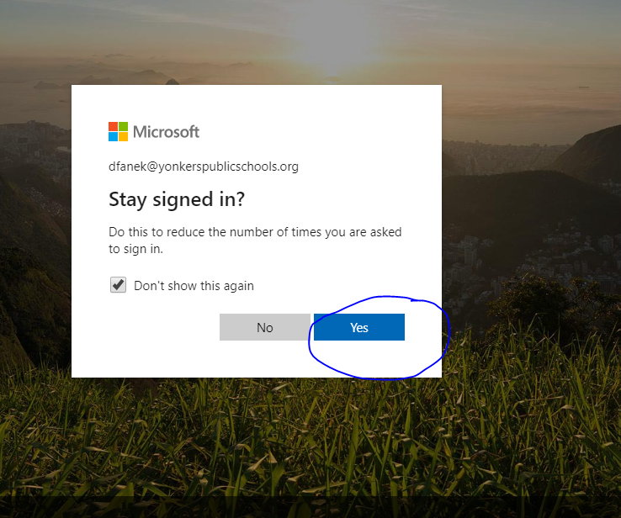
Check the box and select yes

Slide 7
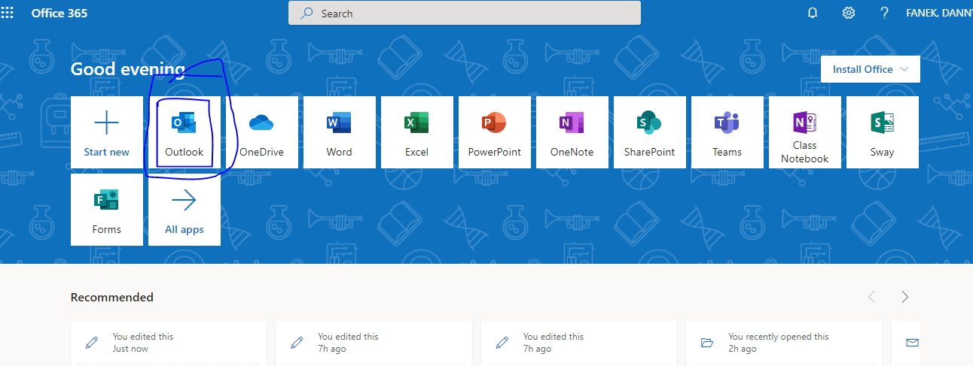
Select Outlook

Slide 8
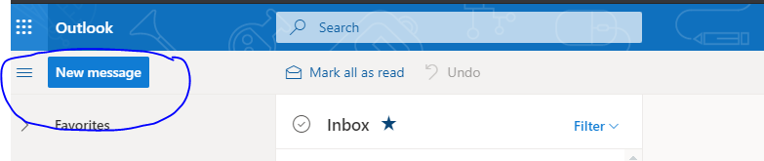
Select New Message

Slide 9
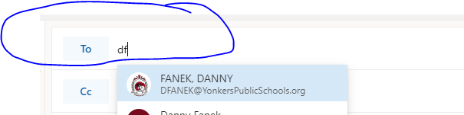
Type in Teachers name

Slide 10
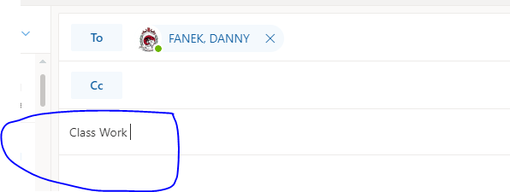
Add a subject

Slide 11
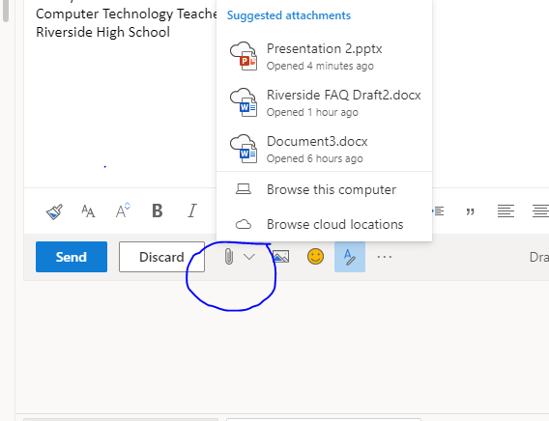
Select Insert on the bottom next to Discard

Slide 12
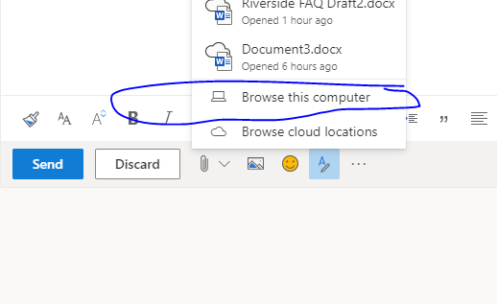
Select Browse this computer to locate file

Slide 13
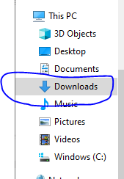
If the file was downloaded from website, select downloads on the left

Slide 14
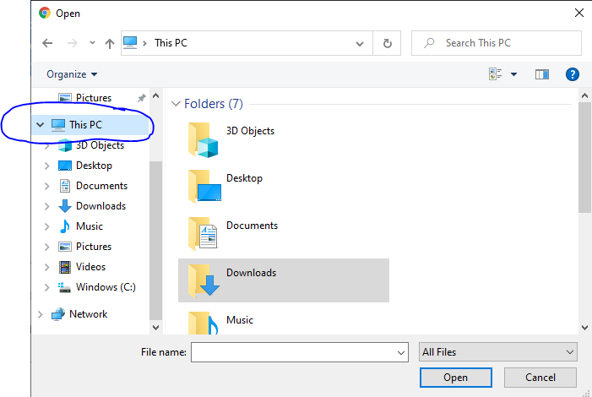
If not, select This PC or My computer on the left

Slide 15
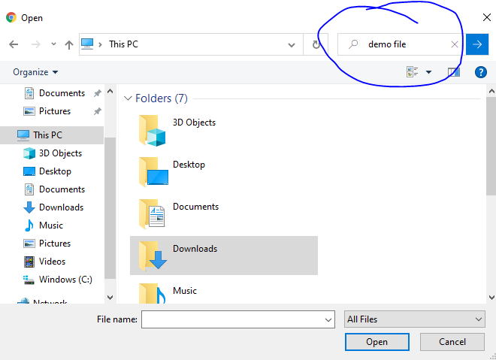
Select Search This PC on the top right and insert the name of the file

Slide 16
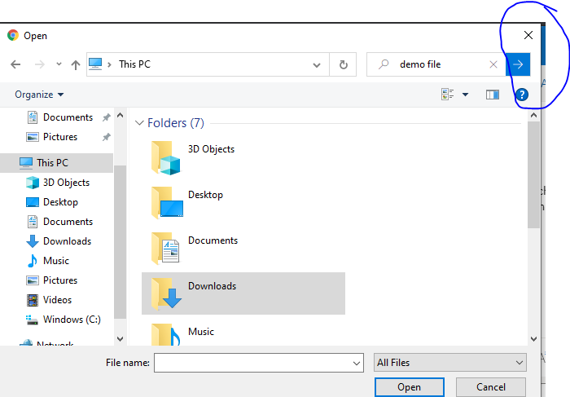
Select the blue arrow pointing right

Slide 17
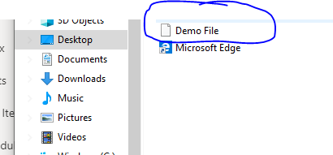
Select the file you want to insert

Slide 18
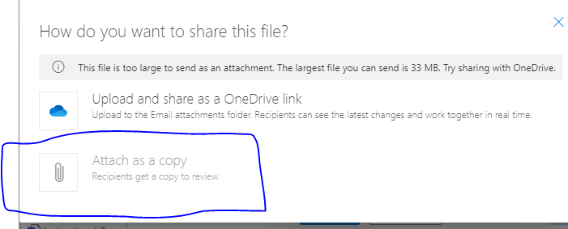
Select Attach as a copy if it asks but it shouldn't

Slide 19
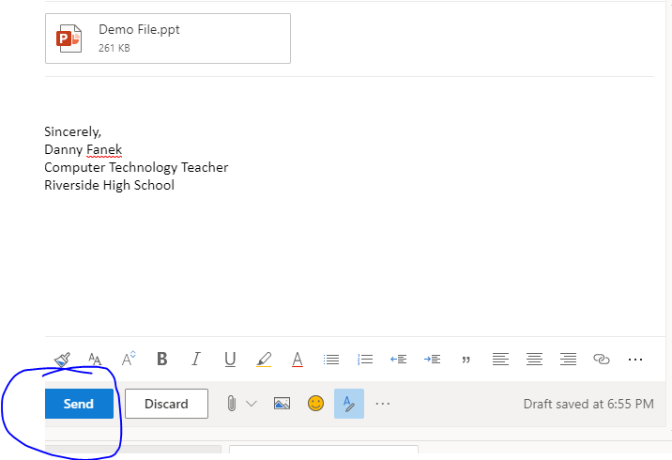
Send once complete

